Slide 1
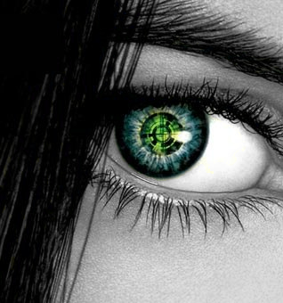
SMART EYESIGHT
AIIP/S
Yanilette Lopez Duprey
Emanuel Rivera Castro
Joaquin Pockels Balaguer

Slide 2
Presentation
Objectives
Product Perspective
Smart Eyesight Perspective
Introduction
Image Processing
PNN Training
Image Classification
Interfaces
Hardware Interface
Software Interface
Communication Interface
Design Implementation Constraints
Assumptions And Dependencies
Requirements
Organization Diagram

Slide 3
Objectives
Extracts relevant features from an incoming stream of images by using traditional features extraction algorithms and statistical methods
Train a probabilistic neural network using the relevant features obtained from UAV incoming images
Identify provided images based on its neural network training
Provide feedback to mayor project's interconnected inverse file query system.

Slide 4
Objectives (cont.)
Designed as an extensible software for CUDA code conversion
Designed as an independent system or module
Interconnection structure of the Smart Eyesight application with the main proposed system is to be established and validated with the consent of developers of the dependent sub-systems and the client himself

Slide 5
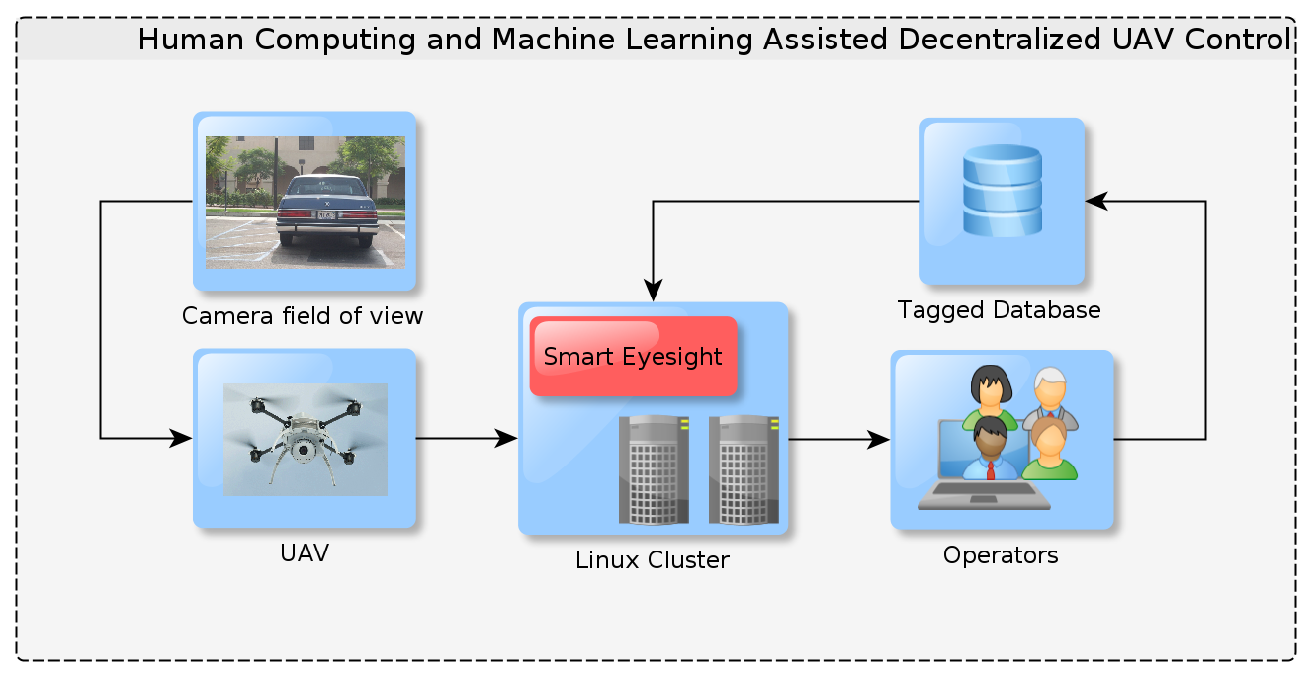
Product Perspective

Slide 6
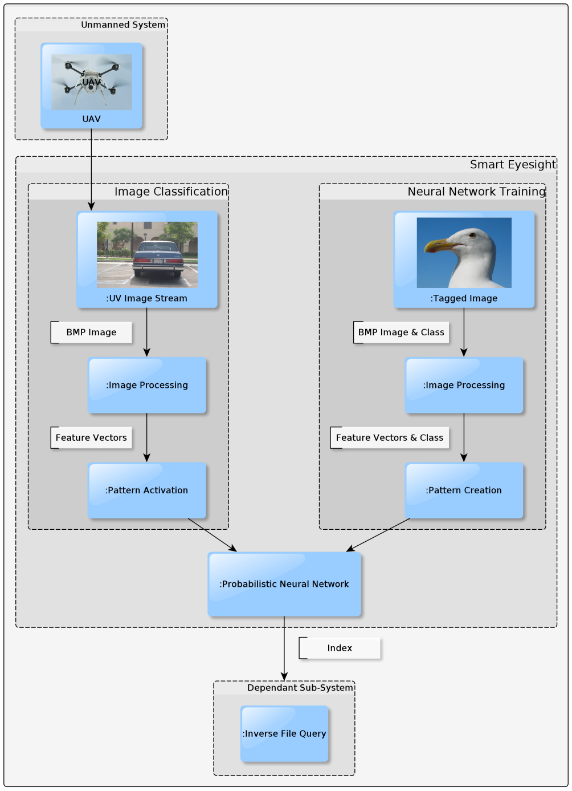
Smart eyesight perspective

Slide 7
Image processing
This function is responsible for the efficient and effective retrieval and description of the content of the image by using the Finding Regions in Pictures method. As mentioned in section 2.2.3 the image processing function is divided into four sub-function:
1. Read Image
2. Segment Image
3. Extract Features

Slide 8
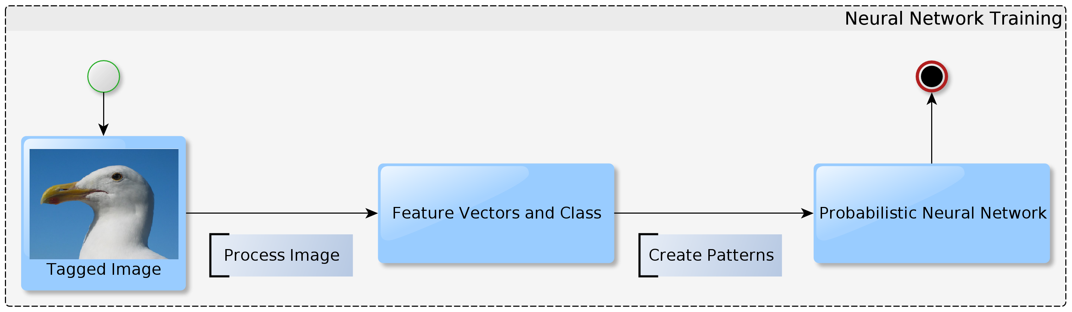
Neural Network Training

Slide 9
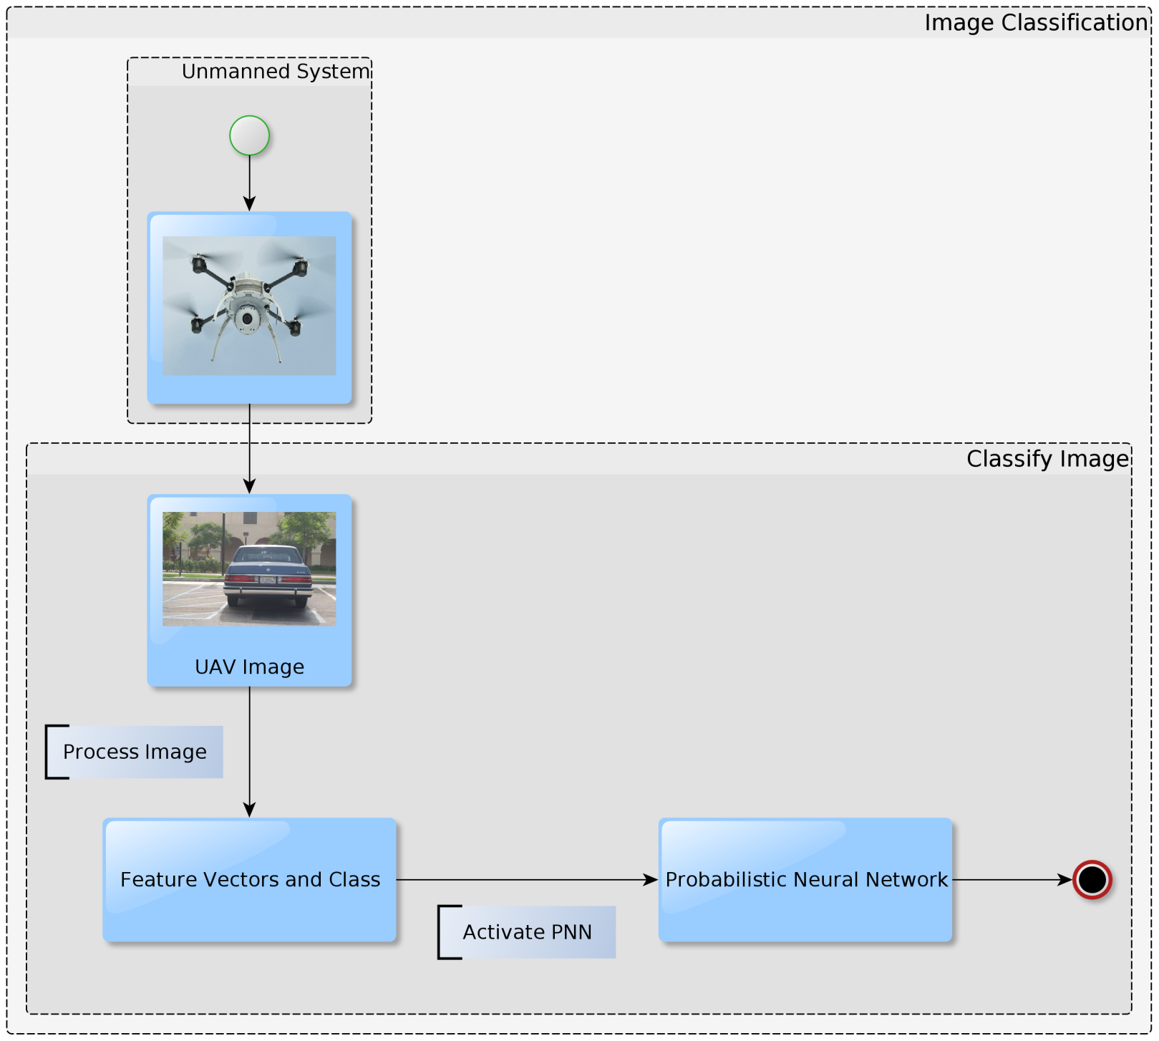
Image Classification

Slide 10
Hardware interface
Smart Eyesight’s original hardware infrastructure is composed of:
Linux-based head nodes. Through the use of switches, these nodes are connected to access points, relay servers and image processing dedicated clusters which compose to the full system. However, since the application serves as a model of the CUDA extended infrastructure, most of the process is carried in a single linux OS computer and tasks such as the PNN training in a separated cluster for a reasonable task resolution time.
Smart Eyesight obtain each UAV incoming image through wireless connections between access points.

Slide 11
Software Interfaces
Smart Eyesight runs on recent linux-based operating systems such as Ubuntu and Fedora.
Dependencies are obtained through wireless and wired TPC/IP and FTP.
The software is extensible through the use of C programming and variants such as CUDA C.
The index obtained from the classification phase is send to the dependent subsystem which uses this information for the inverse file query task.

Slide 12
Communication Interfaces
A custom TCP/IP with FTP program is used for obtaining the dependencies.
The image processing function uses these dependencies to create and obtain the normalized feature vectors used in the next two phases.
The training process receive feature vectors obtained from the tagged image database.
The Classification process receive feature vectors obtained from the UAV image stream.

Slide 13
Design and Implementation Constraints
Image Constraints
Imported Image:
BMP format
Header is converted to BMP format as described by the Image Processing in C book if necessary during image processing.
Content is converted to the RGB/YUV format if required.
Processed Images:
are stored as volatile data and are “liberated” from dynamic memory after use.
Image Processing Constraints
Finding Regions in Picture is used as a Region Based Image Retrieval method
A circular filter, must be used to reduce noise and other undesirable factors of the image
Segmentation must be as efficient as possible
Extracted features should be described briefly and effectively
Five specific features are extracted as described in section 2.2.3
A maximum of a hundred regions are segmented per image
2.4.3 Neural

Slide 14
Design and Implementation Constraints
Neural Network C
A Probabilistic Neural Network structure is used for the training and classification tasks
For the training function, the PNN use feature vectors of regions of images extracted from
the tagged image database
For the classification function, the PNN use feature vectors of regions of images extracted
from the unmanned system’s image stream

Slide 15
Design and Implementation Constraints
Design Constraints
Feedback to the interconnected dependant sub-system is in the form of a classification index, which format is in accordance to the established inverse file query structural design implemented by the developers in charge of the task
Software’s code is written in C programming language
Linux-based Operating Systems are used to develop the application. Linux OS include but are not limited to Ubuntu and Fedora
Smart Eyesight software is not responsible for the application programming interface present between interconnected sub-system. Only formats will be considered as explained in this section.

Slide 16
Assumptions and Dependencies
Dependency: Smart Eyesight depends on the images incoming from the Unmanned System and tagged database.
Assumption: Images received from ether source are not corrupted. Meaning image headers and containing visual data have a fully readable header format and are considered digital images.

Slide 17
Requirements
Image Processing:
Image segmentation Region-Based Image Retrieval application shall be the Finding Regions in Picture
Five specific features ()shall be extracted from the segmented image's regions
Maximum number of regions shall be 100

Slide 18
Requirements
Train PNN:
Use a Probabilistic Neural Network for training
The PNN use normalized feature vectors as input
The feature vectors used in the PNN are extracted from the image processing shared process
Images and class per image index used in this function are provided by the tagged image database

Slide 19
Requirements
Use a Probabilistic Neural Network for classifying images
The PNN use normalized feature vectors as input
The feature vectors used in the PNN are extracted from the Image Processing shared process
Images used in this function are provided by the UAV

Slide 20
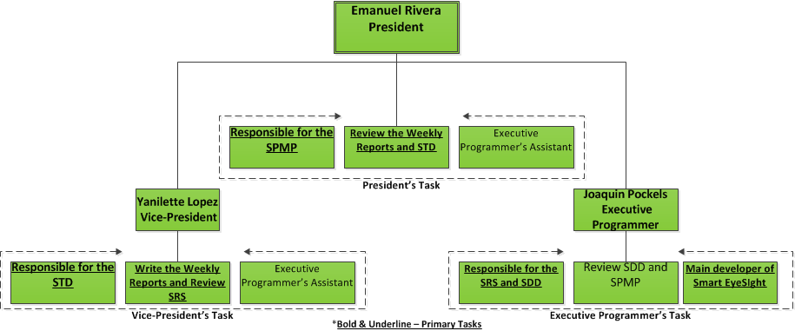
organization Diagram

Slide 21
Thanks for your Attention

